Slide 1
My Career Exploration
By: Jake S

Slide 2
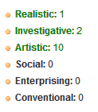
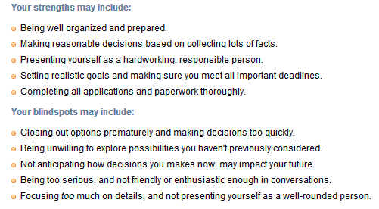
I started my research by taking surveys to learn more about myself
I took a total of two surveys, one for personality and another for interests
As mentioned above, my personality type is ESTJ
Military, Protective Services, Government, and Law are the most interesting types of careers to me.

Slide 3
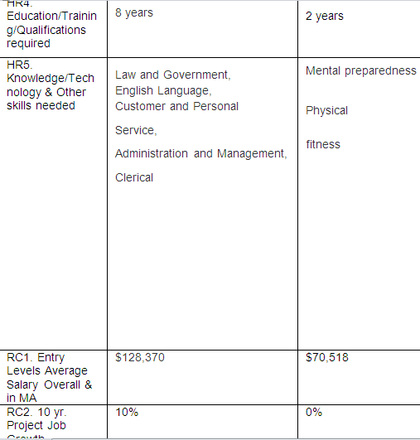
After the surveys I looked up information on all the careers
Said information includes stuff such as knowledge and other skills needed, similar occupations, task/activities/working conditions, etcetera
All the information that I collected was recorded into a Microsoft document

Slide 4
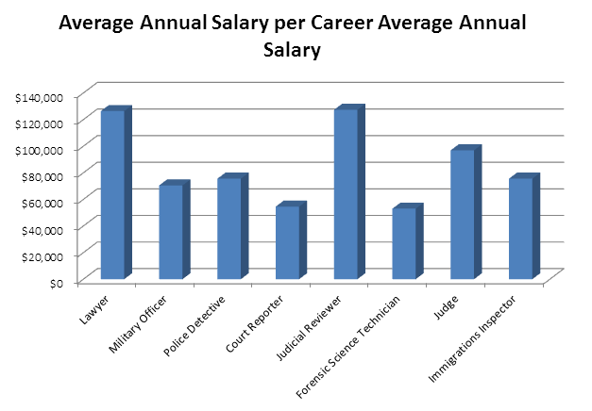
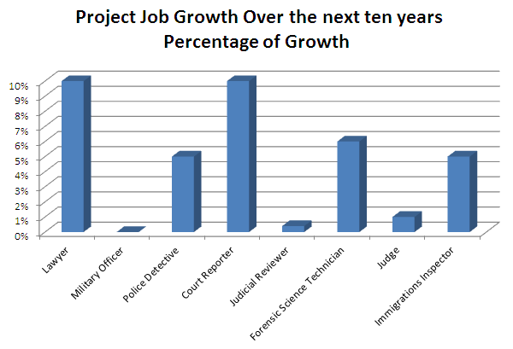
Once I was done gathering information, I graphed three bits of the information to compare them
First I graphed Job Growth Over the next Ten Years. Court Reported and Lawyer tied for most job growth
Then I graphed Years of Education Required. Lawyer and Judge tied for most years needed.
The final thing I graphed was Annual Salary. Being a Judicial Reviewer pays the highest.

Slide 5
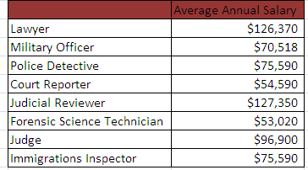
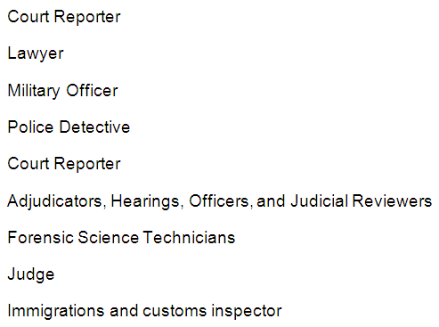
In total I went though eight jobs that I might want to be
The jobs I choose are categorized within Government, Law, and Protective Services
The eight jobs I choose are Lawyer, Military Officer, Police Detective, Court Reporter, Adjudicators Hearings Officers Judicial Reviewers, Forensic Science Technician, Judge, and Immigrations and Customs Inspector

Slide 6
Government and Law
Protective Services
Evenly, there are four of each jobs I choose
Lawyer because many people say that because my interest in government, I should be one
Court Reporter because it sounded like a simple jobs with good growth
Judge because it is rather interesting career with resalable pay
Judicial Reviewer because it sounds like a simple, high paying career and is somewhat interesting
Forensic Science Technician because it sounded like an interesting jobs
Immigrations inspector because I thought in could be an interesting career
Police Detective because it’s the closest one to a military career and has better pay
Military Officer because I’ve always been interested in military and I wouldn’t mind being in it

Slide 7
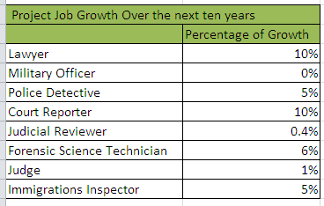
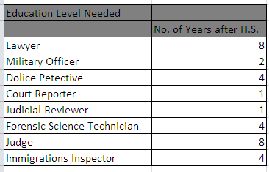
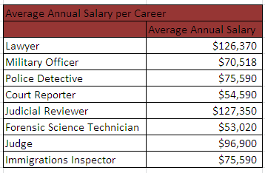
With the information I got about each career I was able to decide which careers I would like the most and least
Job growth is the fourth most important thing for my decision
Third most important thing is education years required. The less education required the high it was on my list because I would rather get into the job as soon as possible rather that spend years learning how to be one
The second most important thing to me is salary because with a high paying job, I could get a lot of money
The most important thing to the career in my opinion is how interested I am in it because if I’m not interested in it, I wont like the job if I take it up.

Slide 8
3. Lawyer
My third place career in this list is Lawyer
One reason for being a Lawyer is because it is the second highest paying job in my list, with an annual salary of $126,370
Also, Lawyer has the highest job growth.
The main reason I wouldn’t want to be a lawyer is because I’m not all that interested in being one
Lawyer also requires the most education years in my list and I don’t want to spend to long studying to be one rather than getting into the job (even though I know I cant)

Slide 9
2. Judicial Reviewer
Judicial Reviewer is my second highest rated job on my list
One reason why is because I has the highest pay of all eight jobs, paying $127,350
In addition to the highest paying job it also has the lowest years of education required
Being a Judicial Review, while having the high pay and low education years, I’m not the most interested in being a Judicial Reviewer, but still more interested that being a Lawyer
Also Judicial Reviewer has the second lowest job growth of all these careers

Slide 10
1. Military Officer
My favorite job on this list is to be a military officer
The main reason why is because it’s the only career I’m fully interested in
It also requires only about two years of training
It doesn’t give the highest pay but its not close to the lowest pay. Military pays $70,518 per month
The other disadvantage is it has a very low job growth of zero to -22.

Slide 11
Citations
There are also other careers I could want such as a game designer, but the jobs that I listed are still great jobs to take up. I still have s couple of years to decide what I want for a career though. Once I need to, I will make a final answer.
http://www.howmuchcost.org/wp-content/uploads/2013/01/How-Much-Does-a-Lawyer-Cost.jpg
http://www.kirk.senate.gov/images/gavel.png
http://www.thedailysheeple.com/wp-content/uploads/2013/06/soldiers.jpg

